Slide 1

C# and .NET Development in VS Code for Beginners
Leslie Richardson
Sr Product Manager
.NET Team

Slide 2


What’s covered in this series?
What is VS Code and C# Dev Kit?
Installing VS Code and C# Dev Kit
Project Management
C# Productivity
Debugging
Testing
Outro / Contributing to C# in VS Code

Slide 3

Episode 1: What is VS Code and C# Dev Kit?
C# and .NET Development in VS Code for Beginners

Slide 4
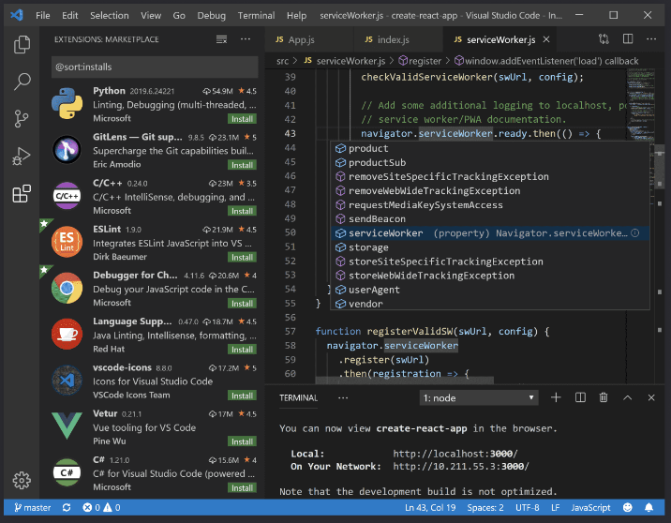
What is VS Code?
Lightweight, source code editor
Multi-language support
Cross-platform support
Windows
Linux
Mac
Code anywhere
GitHub Codespaces
Microsoft Dev Box
Web-browser
Open Source
Extension-driven user customization

Slide 5

VS Code vs. Visual Studio IDE
Editor-based experience
Extension/add-on driven customization and tooling
Cross-plat support across Mac and Linux
Integrated development environment (IDE)
More out-of-the-box customization and tooling
Windows-focused support

Slide 6

What is C# Dev Kit?
Official Microsoft extension
An extension providing rich C# language support and productivity features
Integrates VS productivity features into VS Code
Allows you to write C# anywhere!
Notes:
VS Subscription required – FREE for personal, academic, and open-source use

Slide 7
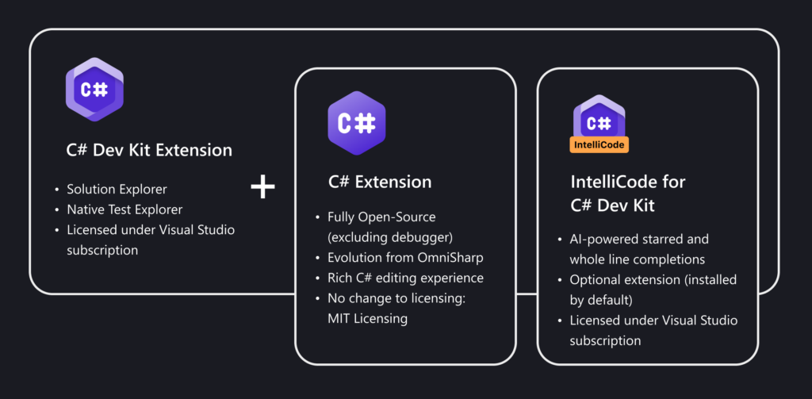


What’s included in C# Dev Kit?
Notes:
An extension providing rich C# language support and productivity features including:
Solution Explorer for project management
Editing enhancements like refactorings, AI-powered code completions, formatting, code navigation (don’t worry, well get to these!)
Streamlined C# debugging and F5 experience
Enhanced testing capabilities via Test Explorer
Additional extension add-ons to further enhance your C# development needs include:
MAUI for C# Dev Kit (check out Maddy’s video to learn more!)
Unity for C# Dev Kit

Slide 8
Next Time: Installing VS Code and C# Dev Kit!

